Slide 1

05/11/2024
Convolutional
Neural Networks
High Performance Machine Learning Group

Slide 2
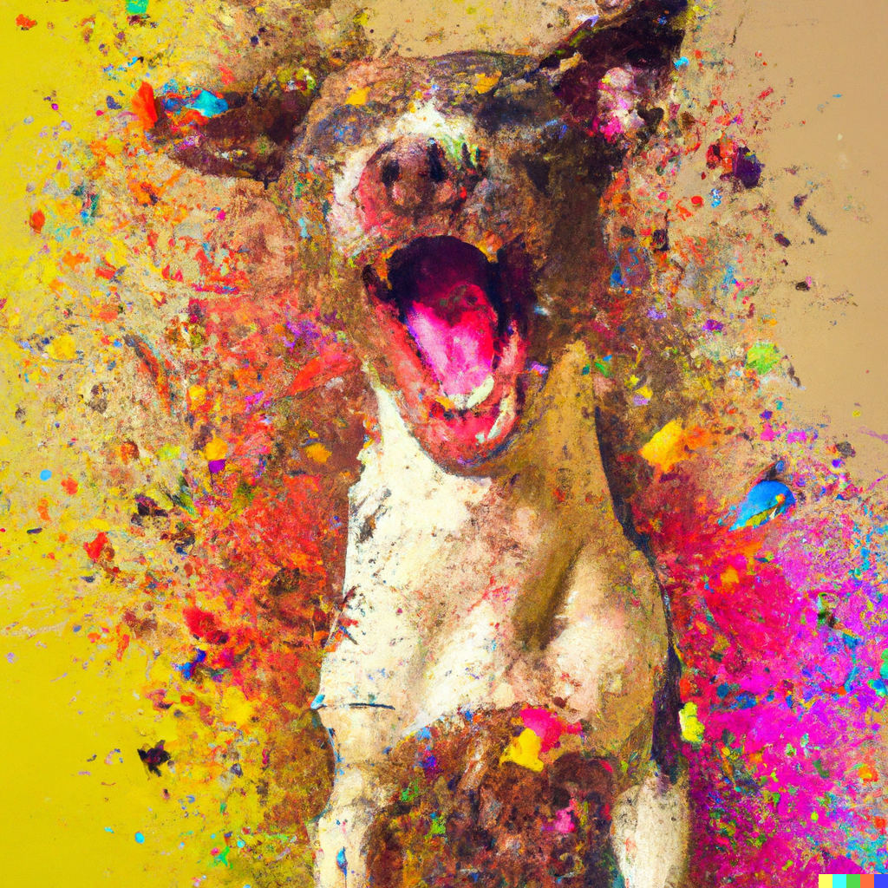


Image Representation
Is a matrix or grid of intensity values
integers [0, 255] or float points [0,1]
Each element in the matrix is a pixel
Can have 1 greyscale channel or multiple colour channels: RGB

Slide 3
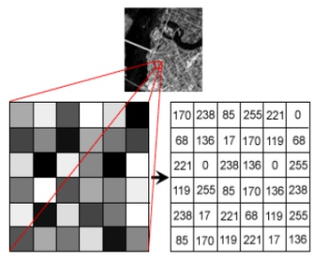
Image Representation
Is a matrix or grid of intensity values
integers [0, 255] or float points [0,1]
Each element in the matrix is a pixel
Can have 1 greyscale channel or multiple colour channels: RGB

Slide 4
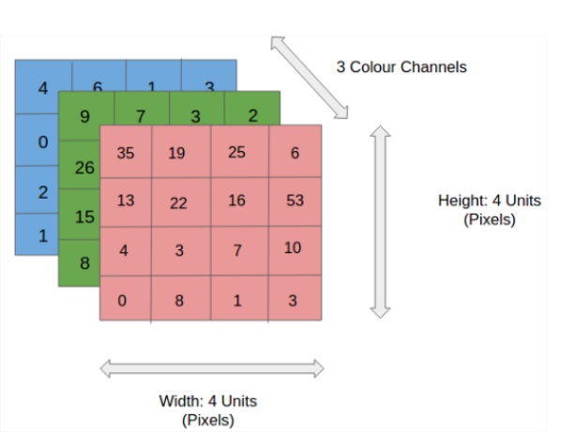
Image Representation
Is a matrix or grid of intensity values
integers [0, 255] or float points [0,1]
Each element in the matrix is a pixel
Can have 1 greyscale channel or multiple colour channels: RGB

Slide 5
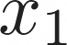

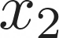
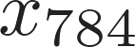
Correlated structures
...
...
...
...
Notes:
We could apply MLPs from previous slides to images by flattening the array, however...

Slide 6
Correlated structures
...
...
...
...
Images are correlated spatially
Strong correlation between neighbouring pixels
Shifting an object will not alter its essence

Slide 7
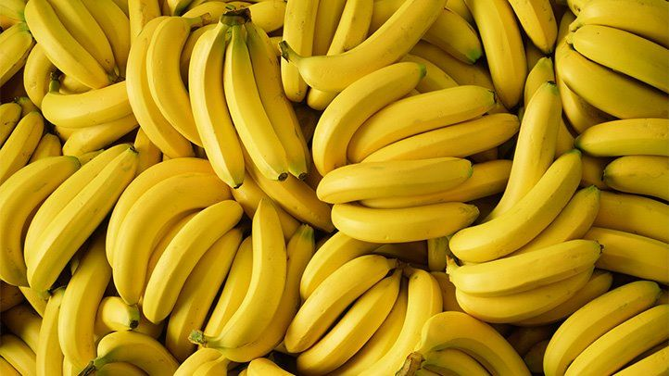
Correlated structures
...
...
...
...
Images are correlated spatially
Strong correlation between neighbouring pixels
Shifting an object will not alter its essence

Slide 8
Correlated structures
...
...
...
...
Images are correlated spatially
Strong correlation between neighbouring pixels
Shifting an object will not alter its essence

Slide 9
Correlated structures
...
...
...
...
Images are correlated spatially
Strong correlation between neighbouring pixels
Shifting an object will not alter its essence

Slide 10
Correlated structures
...
...
...
...
Images are correlated spatially
Strong correlation between neighbouring pixels
Shifting an object will not alter its essence

Slide 11
Correlated structures
...
...
...
...
Images are correlated spatially
Strong correlation between neighbouring pixels
Shifting an object will not alter its essence
We want to detect the features across an image and aggregate them
Form complete features higher up in the hierarchy (in later layers)

Slide 12
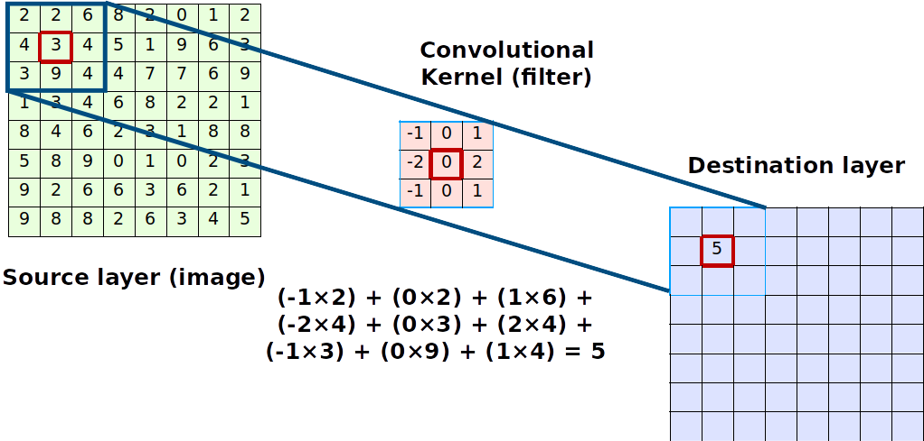

Convolutions Compute
Notes:
We do this with convolutions.
Given a source image, and a convolution kernel...

Slide 13
Convolutions Compute
The kernel is shifted across the image and produces a point value
The step size in which it shifts is the stride
The output is always smaller. We can use padding to preserve dimensions

Slide 14
Convolutions Compute
The kernel is shifted across the image and produces a point value
The step size in which it shifts is the stride
The output is always smaller. We can use padding to preserve dimensions
The image shrinks according to
Output_size = inputSize -(KernelSize - 1)

Slide 15
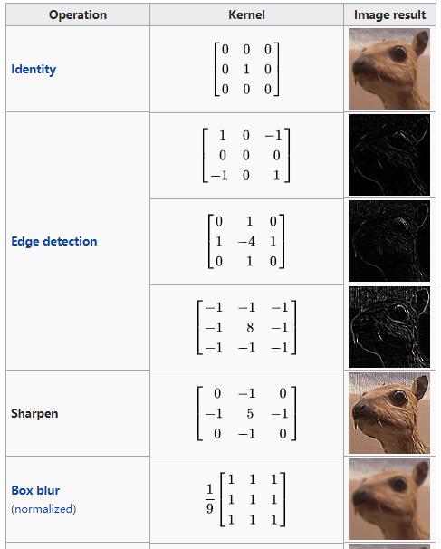
Convolutions
Kernel (filter): small matrix that we use to convolve an image
Convolution:
An operation that “blends” one function with another.
A filter applies a convolution operation on an image
Notes:
Examples of filters

Slide 16
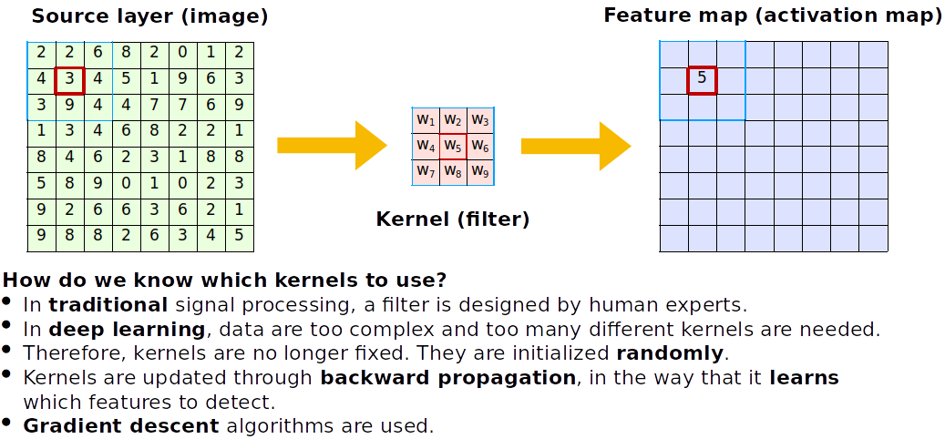
Convolutions
How do we know which kernels to use?
Kernels are initialized randomly and learnt during training, allowing the CNN to learn spatial features

Slide 17
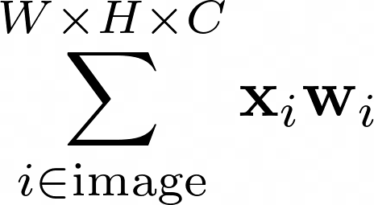
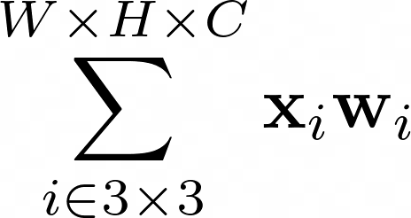
Convolutions
Fully connected
Locally connected
shared weights
How do we know which kernels to use?
Kernels are initialized randomly and learnt during training, allowing the CNN to learn spatial features
Notes:
Where before the entire input contributes to all outputs, here only the input that lies in the kernel "shadow" contributes to the output

Slide 18
Convolutions
Fully connected
Locally connected
shared weights
How do we know which kernels to use?
Kernels are initialized randomly and learnt during training, allowing the CNN to learn spatial features
Notes:
We can then add multiple output channels to increase complexity

Slide 19
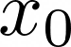
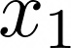
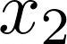
Anatomy of an Convolutional Neural Network
CNNs actually look a lot like normal Dense Neural Networks
Interpretation: Every node is a kernel

Slide 20
Anatomy of an Convolutional Neural Network
See the nodes as moving across the image!
We say these are shared weights
CNNs actually look a lot like normal Dense Neural Networks
Interpretation: Every node is a kernel

Slide 21

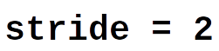
Pooling
Pooling provides some robustness (or invariance) to translations in the image.
We could discard information gradually by max pooling
Keep the strongest signal, works better than average pooling
Nowadays, we use a bigger convolution stridefor dimensionality reduction
Notes:
We can use pooling to reduce the image size

Slide 22
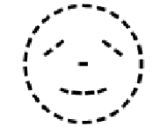
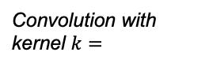
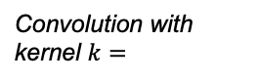
Convolution Translation Symmetry
Convolution output
Max Pooling output (single value)
Input
If a feature translations across the input, its activation similarly moves across the output. This is called equivariance; the output commutes with the transformation on the input
By pooling, we can obtain (local) robustness/invariance to translations.
Convolution with kernel $k=$
maxPool
Translation
Translation
Translation
Convolution with kernel $k=$
maxPool

Slide 23
CNN Cases
High Performance Machine Learning Group
Notes:
Let's discuss some cases where CNNs are applied

Slide 24
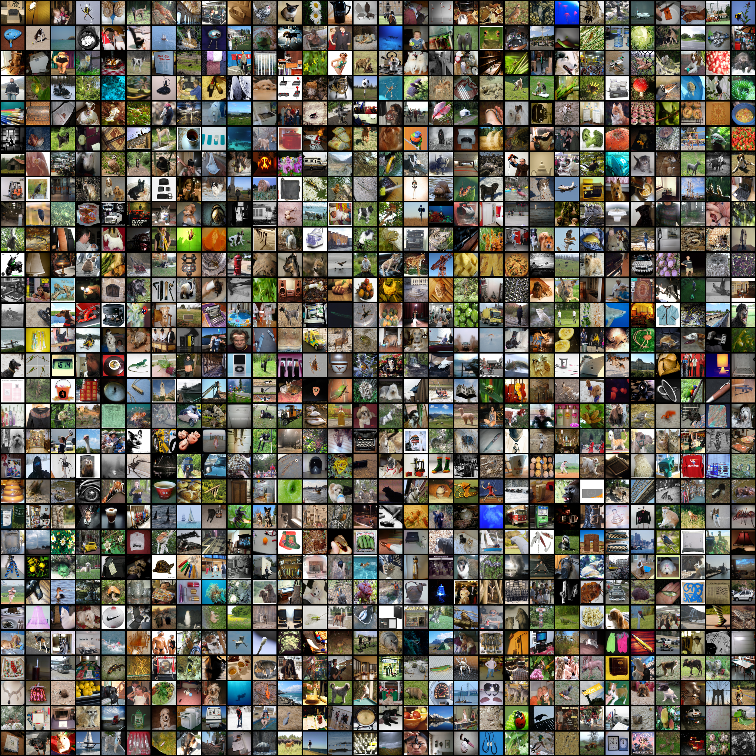

ImageNet Challenge
Computer Vision Benchmark 1.4M Images, 1000 classes
Image Classification Difficult until 2012

Slide 25
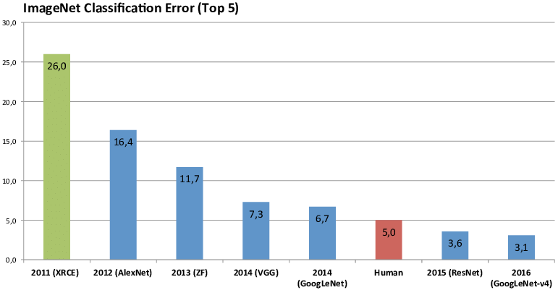
ImageNet Challenge
Computer Vision Benchmark 1.4M Images, 1000 classes
Image Classification Difficult until 2012
Notes:
In 2012 a big step was made by AlexNet, with ResNet first surpassing humans in 2015

Slide 26
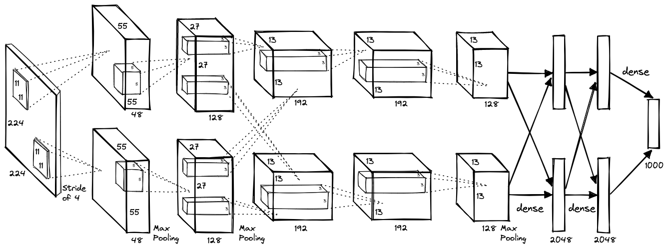
AlexNet (2012)
Notes:
Let's take a look at alexnet. Explain graph

Slide 27
AlexNet (2012)
Images become smaller and number of filters increases as we go deeper
8 layers with dropout and ReLU activations trained for 6 days on 2 GPUs

Slide 28
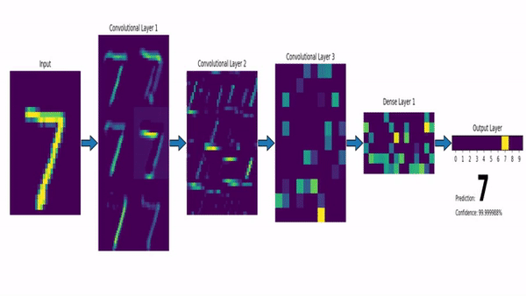
CNN with a Dense Layer output
https://www.louisbouchard.ai/densenet-explained/
Notes:
Example of intermediate features

Slide 29
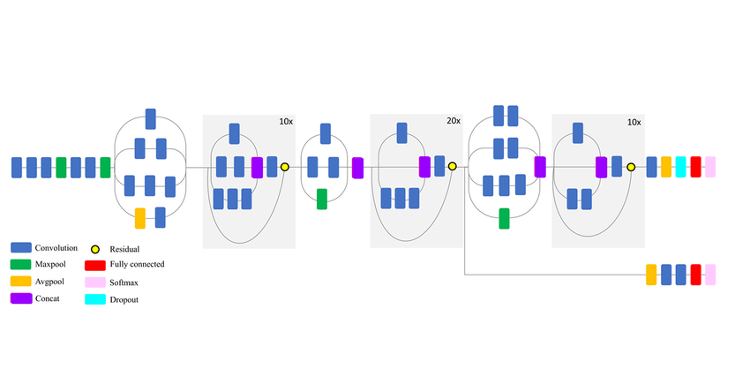
Transfer Learning

Slide 30
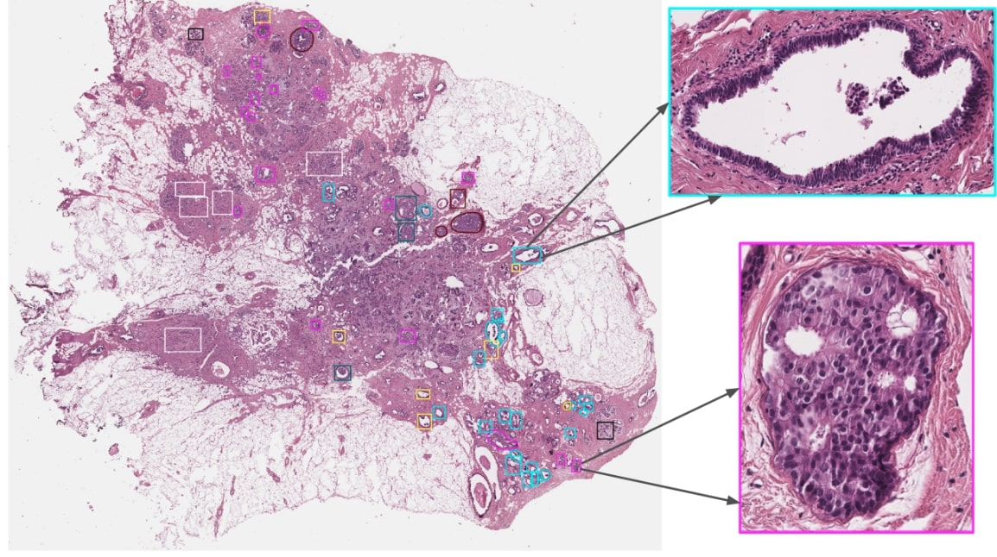
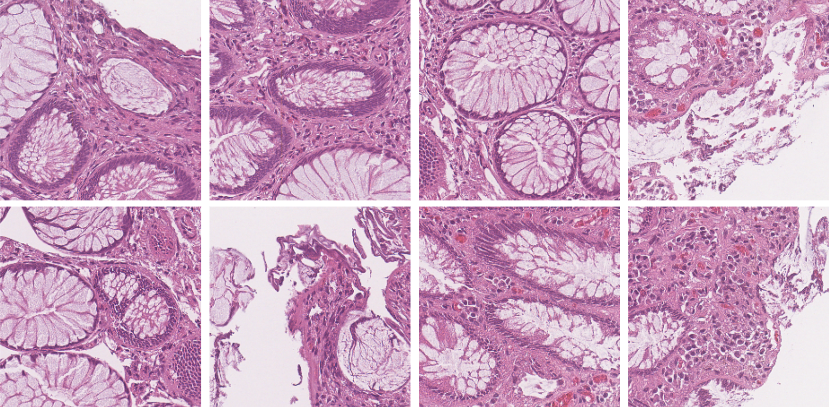
Transfer Learning

Slide 31

VGG16 and ResNet (2014, 2015)
VGG16: construct large and deep models (120M params)
Prevents vanishing gradient problem

Slide 32
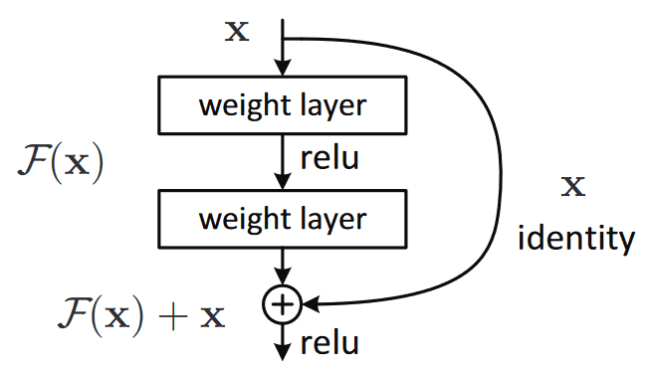
VGG16 and ResNet (2014, 2015)
VGG16: construct large and deep models (120M params)
Prevents vanishing gradient problem

Slide 33
ResNet (2015)
Notes:
Resnet introduced skip connections
Explain skip connections and why beneficial (if f(x) small there is still x)

Slide 34
ResNet (2015)
ResNets: construct large and deep models with skip connections, able to train up to 152 layers (!)
Higher abstraction and less nuisance from vanishing or exploding gradients

Slide 35
ResNet (2015)
ResNets: construct large and deep models with skip connections, able to train up to 152 layers (!)
Higher abstraction and less nuisance from vanishing or exploding gradients
Early layers learn features that get progressively more abstract, we can preserve and control the flow of information with skip connections

Slide 36
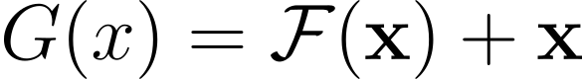
ResNet (2015)

Slide 37
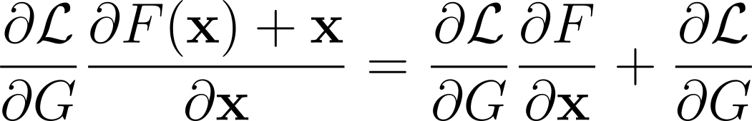
ResNet (2015)

Slide 38
ResNet (2015)

Slide 39
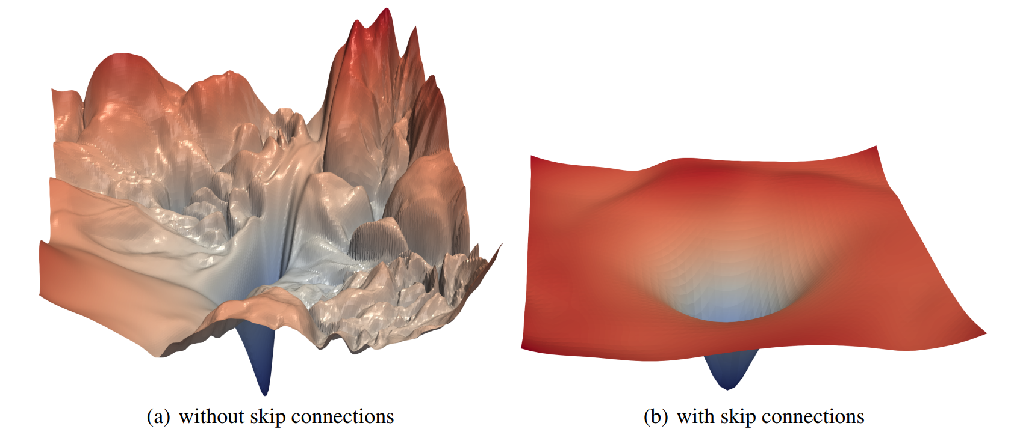
Li, H., Xu, Z., Taylor, G., & Goldstein, T. (2017). Visualizing the Loss Landscape of Neural Nets. NIPS
ResNet (2015)

Slide 40
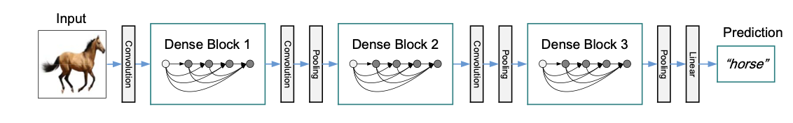
DenseNet (2018)
DenseNets: Let each layer take in the output from each preceding layer in the same block.
Up to 264 layers!

Slide 41
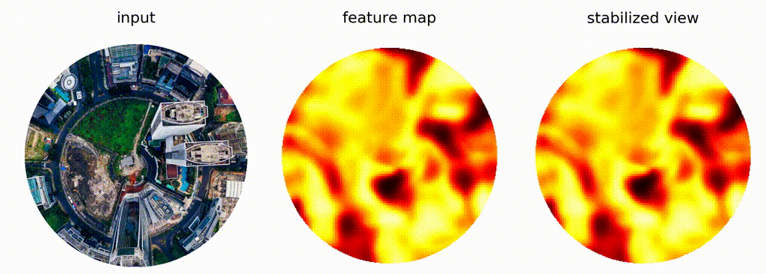
Other symmetries?
We have seen that the sliding kernels/weight sharing gives CNNs equivariance w.r.t translations.
Besides translations, images often exhibit other symmetries that we might want robustness to (e.g. scaling, rotation)
CNNs are not natively equivariant to these transformations.
Rotation
Mirroring
Scaling
Source: https://github.com/QUVA-Lab/escnn

Slide 42
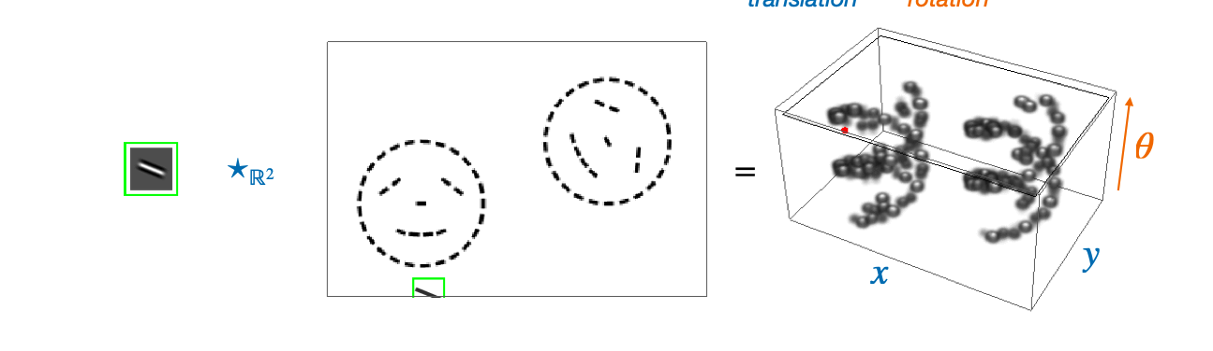
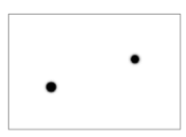
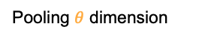
Group Convolutional Networks (GCNNs) (2016)
Also apply the required transformation group G to the kernel at each spatial location.
This adds an additional group dimension, describing how the feature changes w.r.t the group G at each spatial location.
This dimension can also be pooled to obtain invariance.
Pooling $θ$ dimension

Slide 43
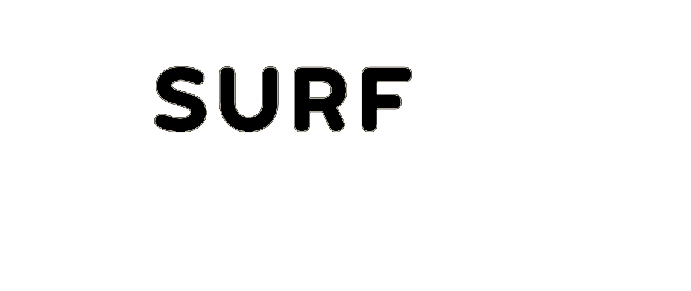
05/11/2024
Thank You
High Performance Machine Learning Group

Slide 44
Slides Graveyard
High Performance Machine Learning Group

Slide 45
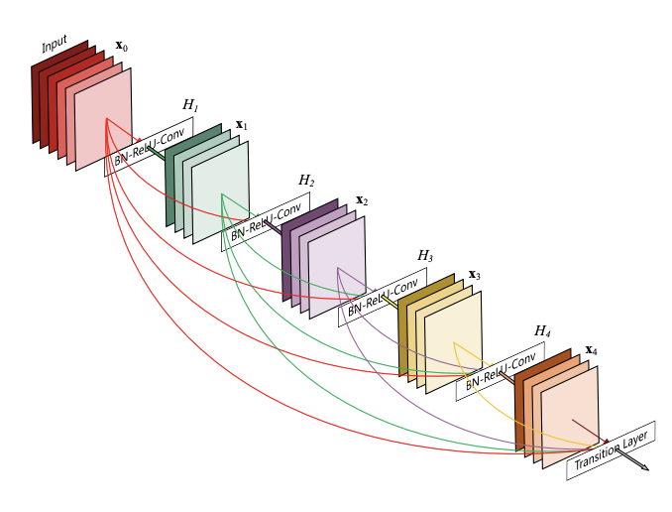
DenseNet (2016)
ResNets: construct large and deep models with skip connections, able to train up to 152 layers (!)
Higher abstraction and less nuisance from vanishing or exploding gradients
Early layers learn features that get progressively more abstract, we can preserve and control the flow of information with skip connections

Slide 46
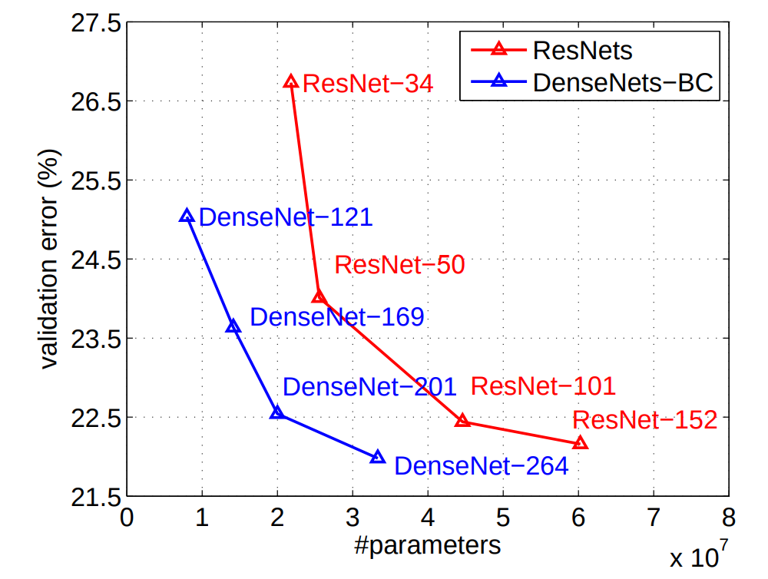
DenseNet (2016)
ResNets: construct large and deep models with skip connections, able to train up to 152 layers (!)
Higher abstraction and less nuisance from vanishing or exploding gradients
Early layers learn features that get progressively more abstract, we can preserve and control the flow of information with skip connections

Slide 47
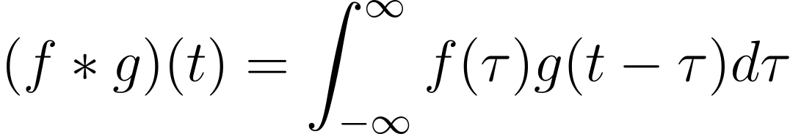
The Convolution Operation

Slide 48
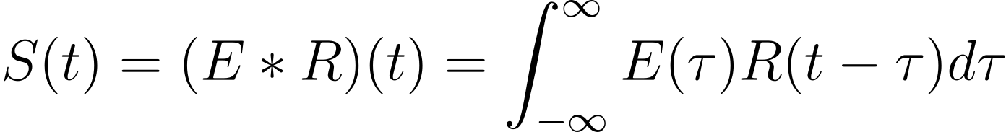
The Convolution Operation

Slide 49
The Convolution Operation
Impulse Response

Slide 50
The Convolution Operation
Source Signal
Impulse Response

Slide 51
The Convolution Operation
Seismogram
Source Signal
Impulse Response

Slide 52
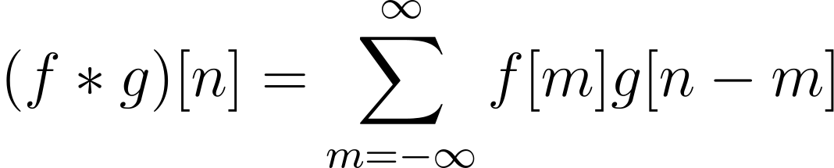
The Convolution Operation

Slide 53
The Convolution Operation
Initial signal gets modified by the system’s response
One signal slides across the other

Slide 54
Convolutions
Kernel (filter): small matrix that we use to convolve an image

Slide 55
Convolutions
Kernel (filter): small matrix that we use to convolve an image
Convolution:
An operation that “blends” one function with another.

Slide 56
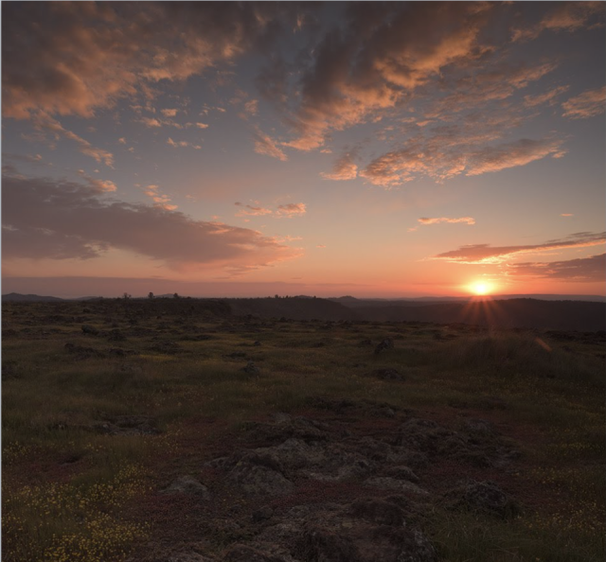

Convolutions
Kernel (filter): small matrix that we use to convolve an image
Convolution:
An operation that “blends” one function with another.
A filter applies a convolution operation on an image

Slide 57

Convolutions
Kernel (filter): small matrix that we use to convolve an image
Convolution:
An operation that “blends” one function with another.
A filter applies a convolution operation on an image

Slide 58
How do Humans see?

Slide 59
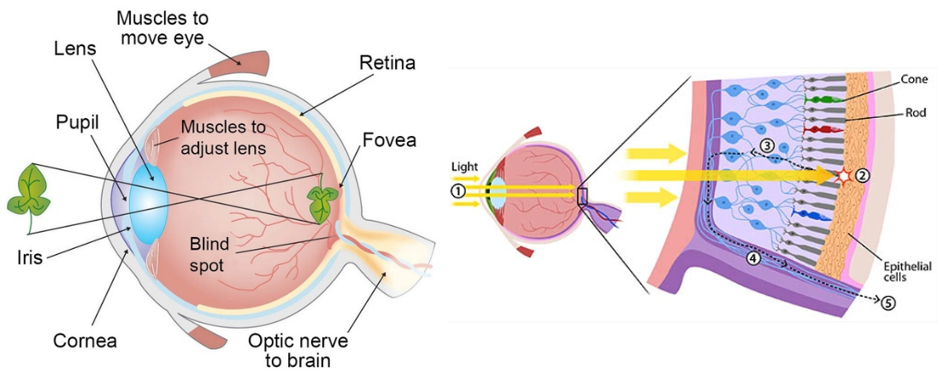
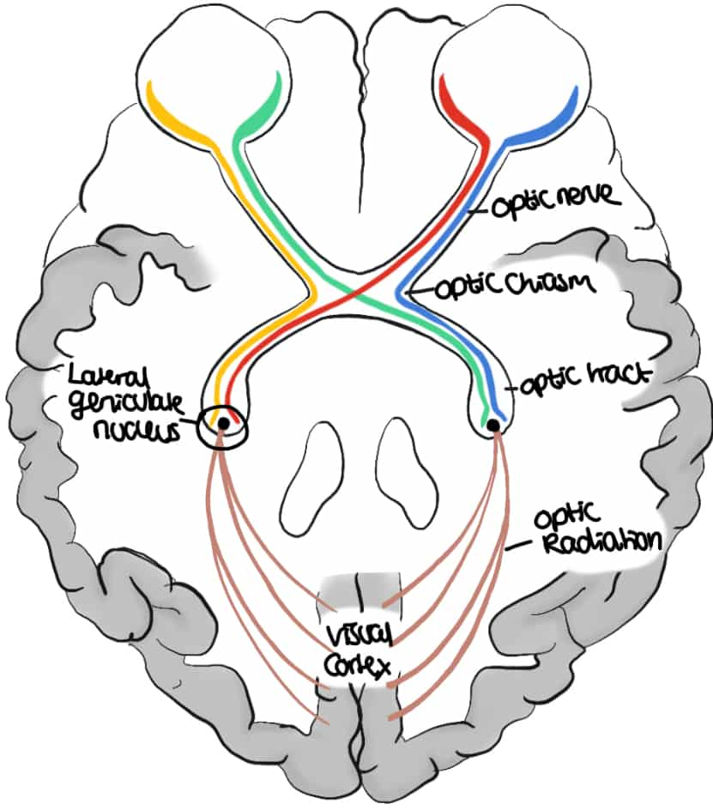
Mammalian Visual System

Slide 60
Mammalian Visual System
Cones and rods picks up photons and propagate the signal to the back of our brain
Along the way, the signal gets processed in stages

Slide 61
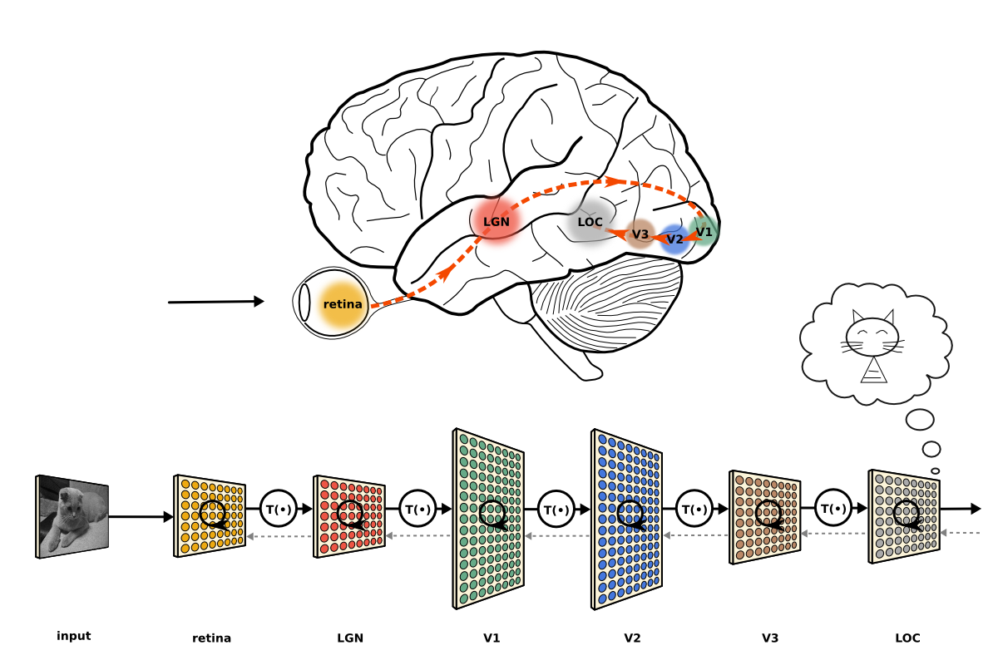
Mammalian Visual System
Cones and rods picks up photons and propagate the signal to the back of our brain
Along the way, the signal gets processed in stages
The extracted information gets aggregated and formed into an image

Slide 62
Mammalian Visual System
Cones and rods picks up photons and propagate the signal to the back of our brain
Along the way, the signal gets processed in stages
The extracted information gets aggregated and formed into an image

